Slide 1
MINI PROJECT
Comparing infrared and visible imagery on cloud type identification on 20th June, 2023 over Ghana

Slide 2
OUTLINE OF PRESENTATION
Introduction
Methodology and data sources
Results and discussion
Impacts of cloud type
Conclusion

Slide 3
INTRODUCTION
Cloud identification is an essential task in meteorology and atmospheric science, with a long history of research and development. According to the World Meteorological Organization (WMO), clouds are classified into ten basic types based on their altitude, shape, and composition. The classification includes high clouds, middle clouds, and low clouds, as well as clouds with significant vertical development, such as cumulonimbus clouds that produce thunderstorms.

Slide 4
METHODOLOGY AND DATA SOURCES
Eumetsatview website was accessed and satellite imageries in the visible and infrared channels were selected and real imageries of 1200UTC and 0600UTC were downloaded for both channels.
Using the images, cloud types were then identified in both channels and were used for analysis
Temperature and boundary layer height data were downloaded from ERA5 and a python script was used to develop spatial plots to show the impacts of the cloud types over the study area.

Slide 5
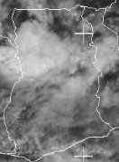
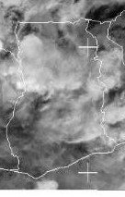
RESULTS AND DISCUSSION
VISIBLE IMAGERY AT 1200 UTC
INFRARED IMAGERY AT 1200 UTC
A
A
B
B
C
C

Slide 6
CLOUD TYPE IDENTIFICATION
POINT A: Located in the region of bright white clouds, their brightness on visible imagery indicates that these are thick clouds. These clouds also appear bright on infrared imagery, so they have cold cloud tops these clouds are appear thick with no sharp edges, it can be assumed as a cumulonimbus or Nimbostratus cloud.
POINT B: On visible imagery the clouds are not as bright and have thin and grayish appearance. These clouds appear whiter and brighter on the infrared imagery indicating a possibility of a cirrus cloud
POINT C: These clouds appear grayish and thin and cover most of the atmosphere distributing uniformly over the region with fuzzy edges or not well defined and hence can be assumed as either stratus or stratocumulus cloud

Slide 7
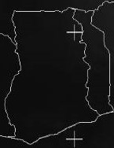
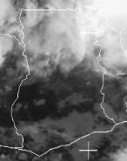
CLOUD TYPE IDENTIFICATION AT 0600 UTC
VISIBLE IMAGERY
INFRARED IMAGERY
G
G
H
H

Slide 8
CLOUD TYPE IDENTIFICATION
POINT G: There are no clouds displaying on the visible imagery due to the absence of sun but note that the area is not cloud free. On the infrared imagery they appear bright and whiter due to their cold cloud tops and hence can be assumed as cirrus cloud.
POINT H: There are no clouds displaying on the visible imagery due to the absence of sun but note that the area is not cloud free but on the infrared imagery they look patchy and gray with warm cloud tops indicating a low stratus or fog.

Slide 9
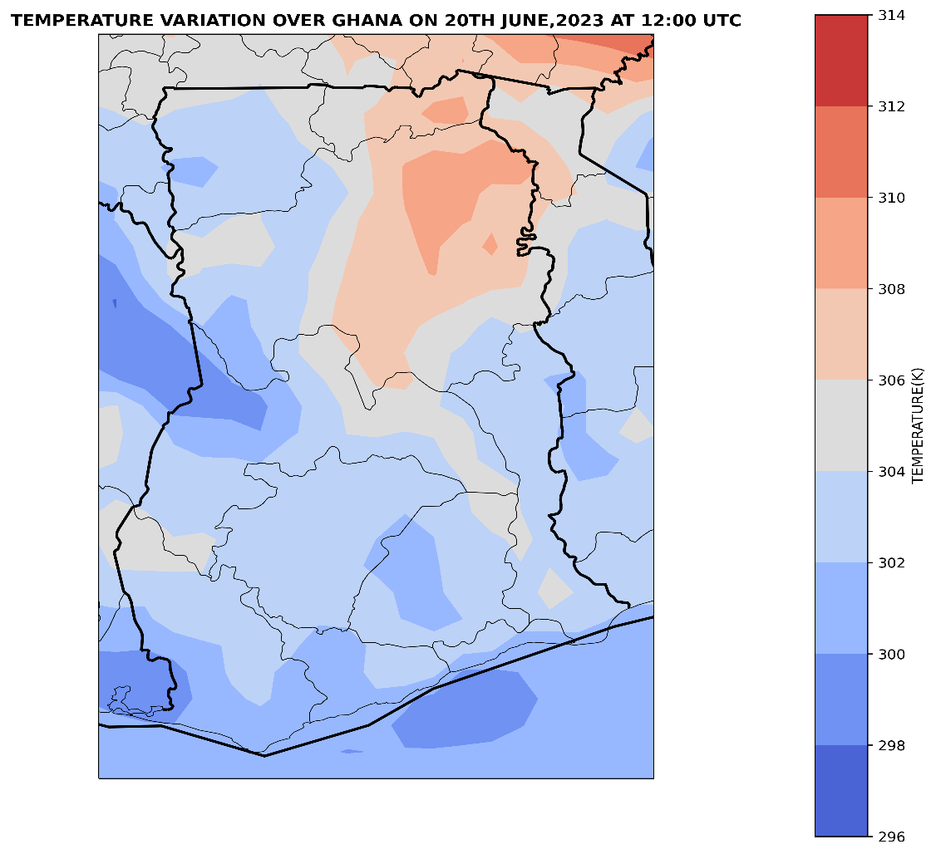
IMPACT OF CLOUD TYPE OVER STUDY AREA
CUMULONIMBUS OR NIMBOSTRATUS
CIRRUS
STRATUS OR STATOCUMULUS

Slide 10
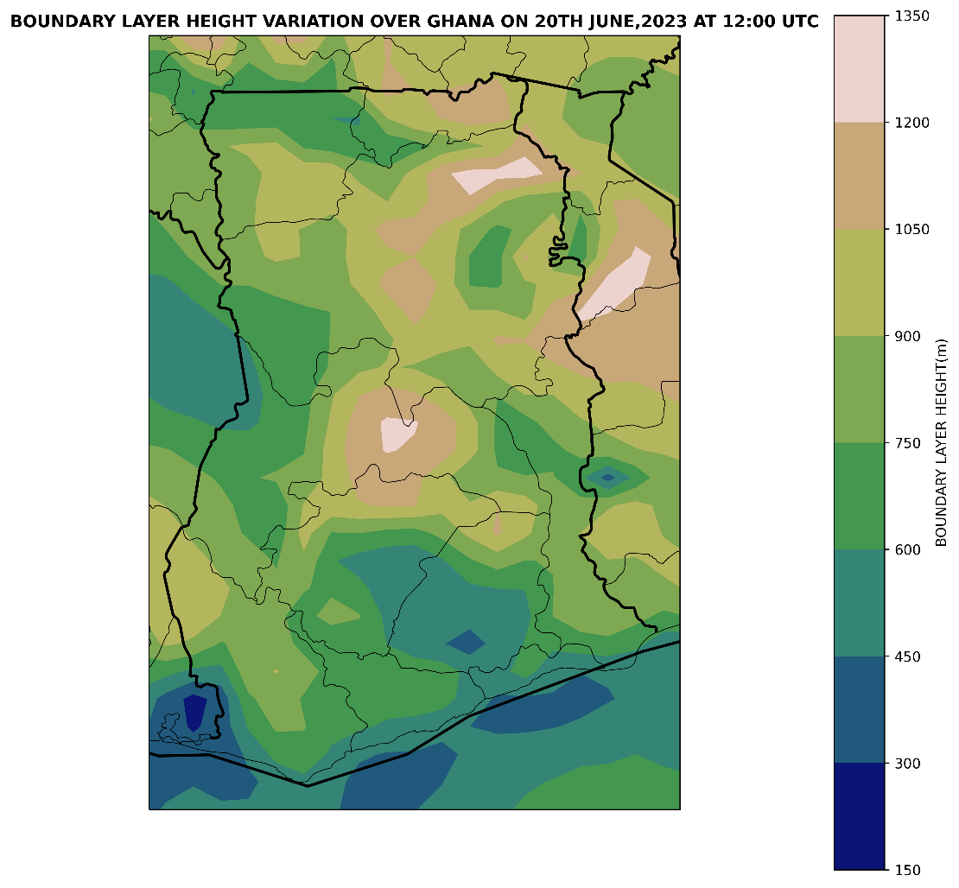
IMPACT OF CLOUD TYPE OVER STUDY AREA
CUMULONIMBUS OR NIMBOSTRATUS
CIRRUS
STRATUS OR STRATOCUMULUS

Slide 11

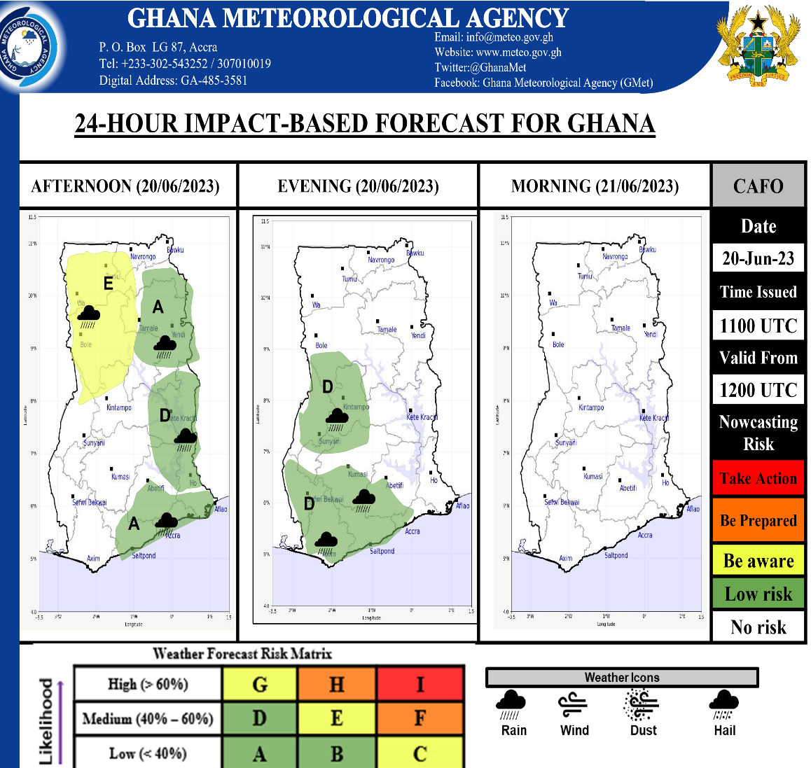
IMPACT OF CLOUD TYPE OVER STUDY AREA
CUMULONIMBUS OR NIMBOSTRATUS
CIRRUS
STRATUS OR STRATOCUMULUS

Slide 12
CONCLUSION
This work compared infrared and visible imagery for cloud type identification over Ghana on June 20th, 2023. Both types of imagery provide different information on cloud properties, with infrared being better at detecting high clouds and visible being better at detecting low clouds. Combining both types of imagery can provide a more complete picture of cloud cover and aid in weather prediction.

